Slide 1
Photo Album
by Dpu Barman

Slide 2
102. Model Inheritance Abstract Base Class MultiTable Inheritance Proxy Model in Django

Slide 3
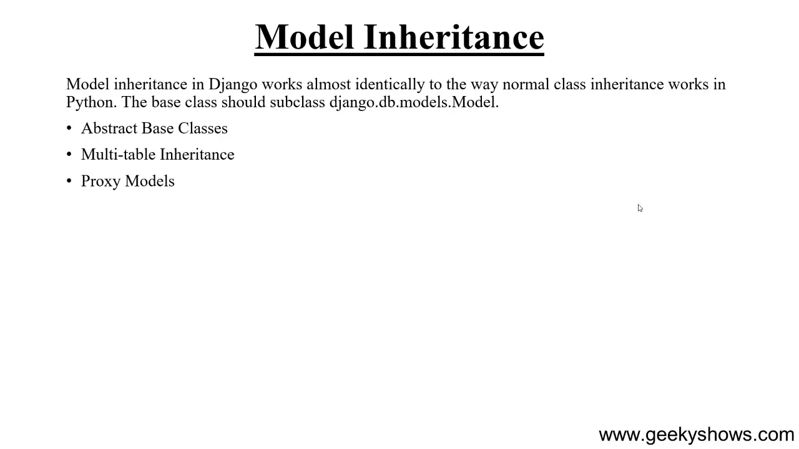

Slide 4
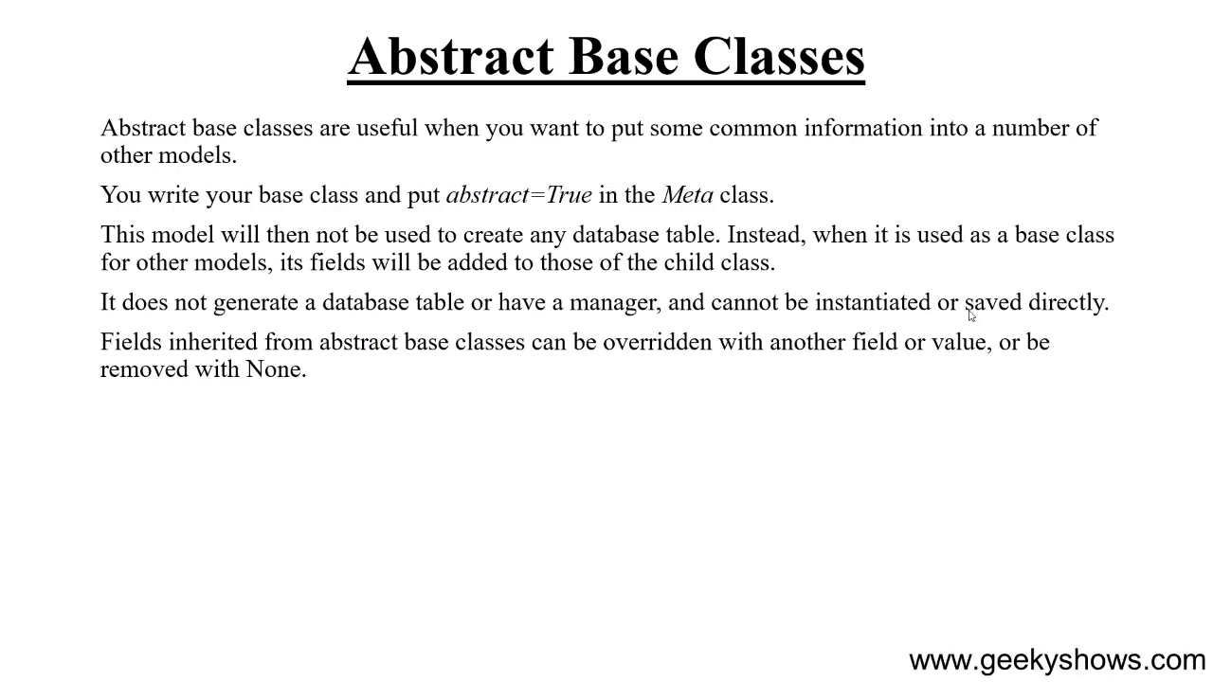

Slide 5
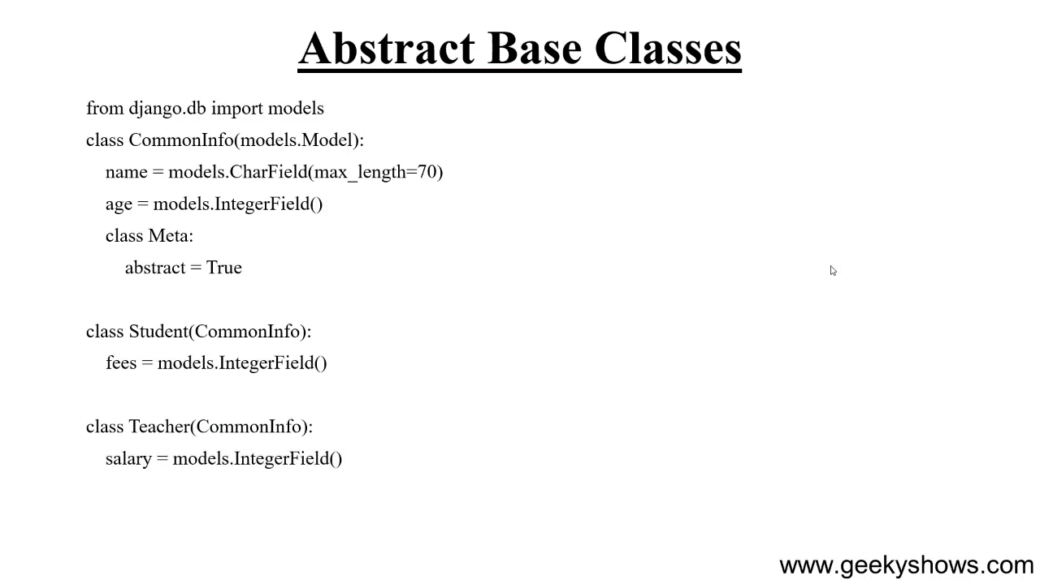

Slide 6
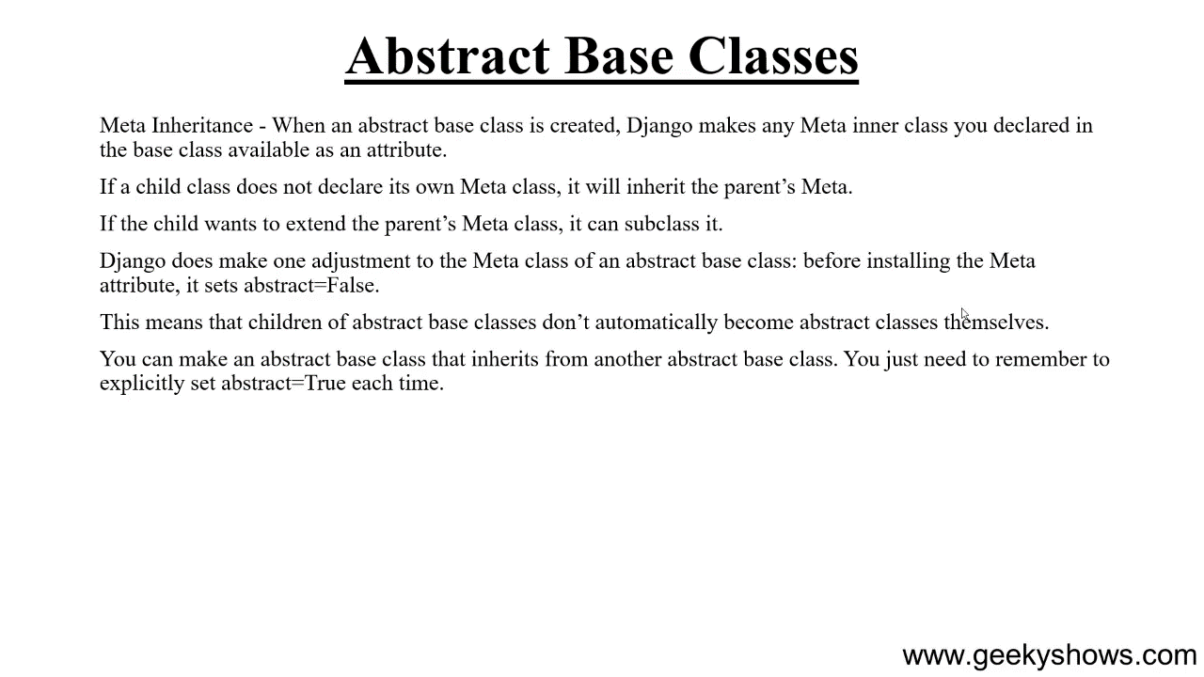

Slide 7
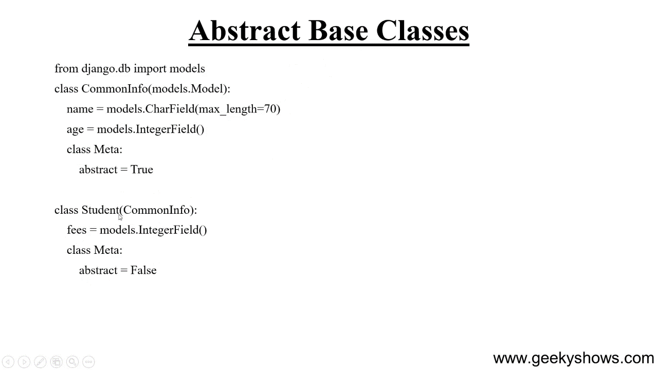

Slide 8
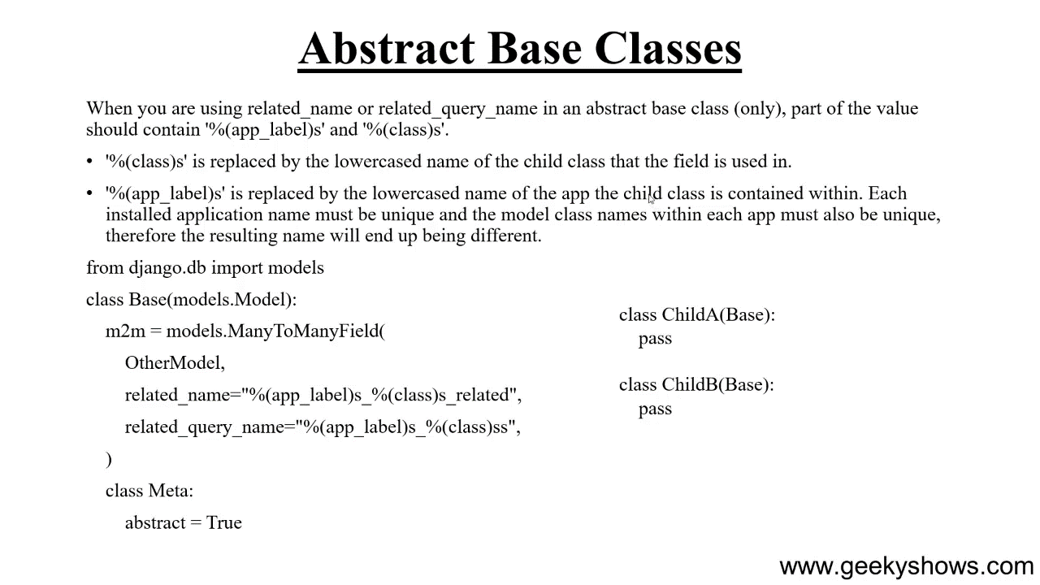

Slide 9
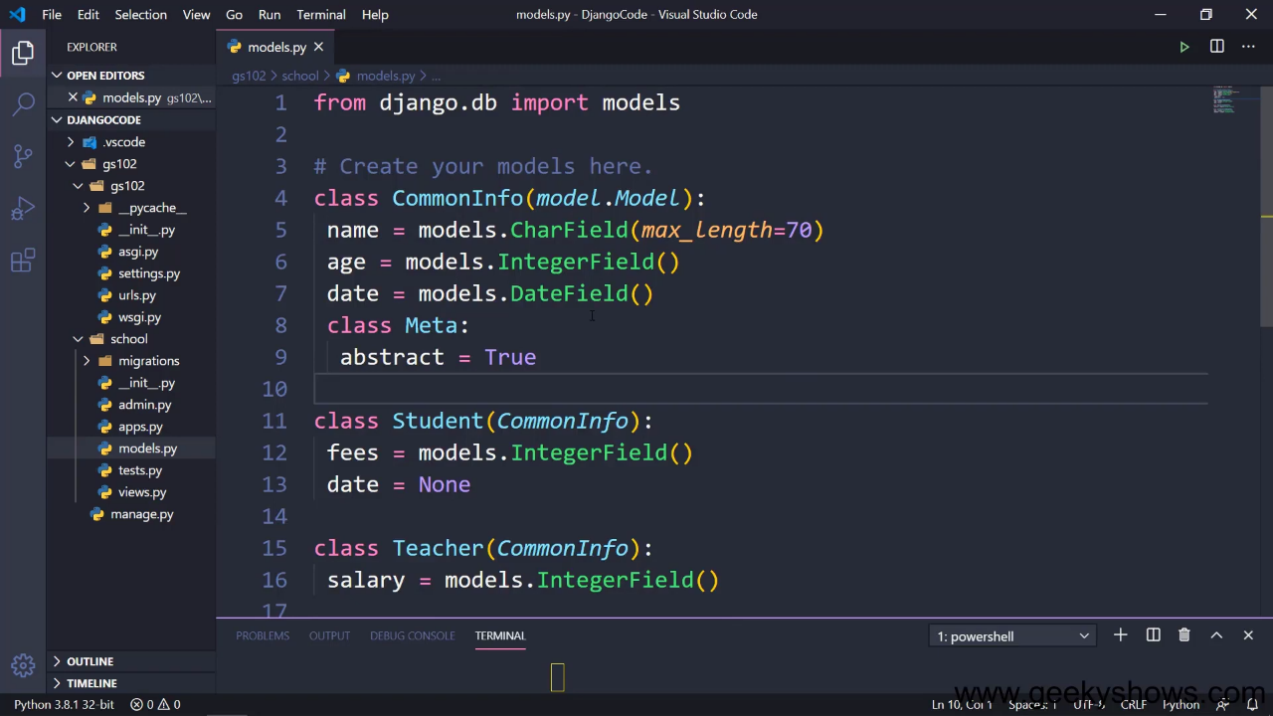

Slide 10
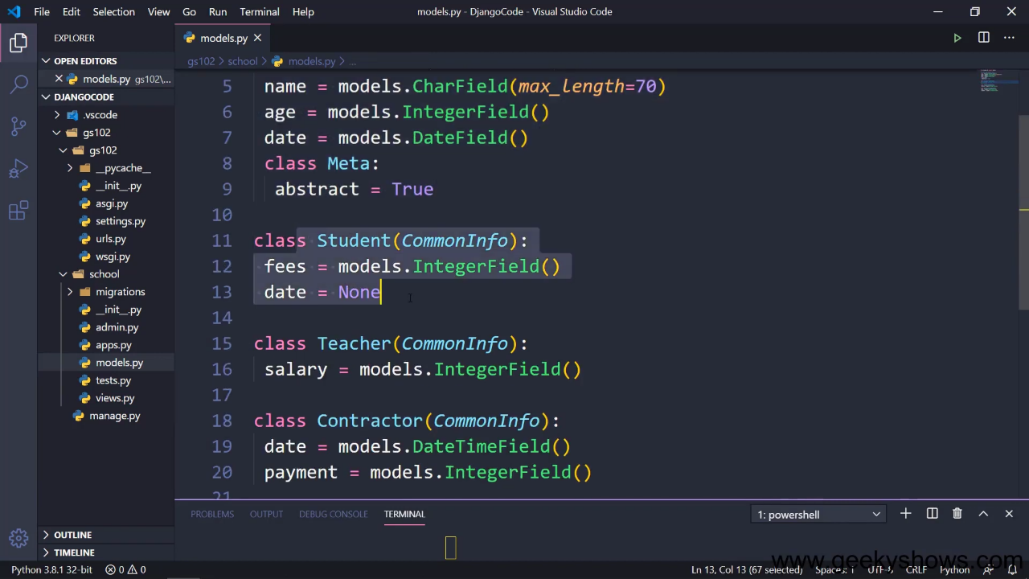

Slide 11
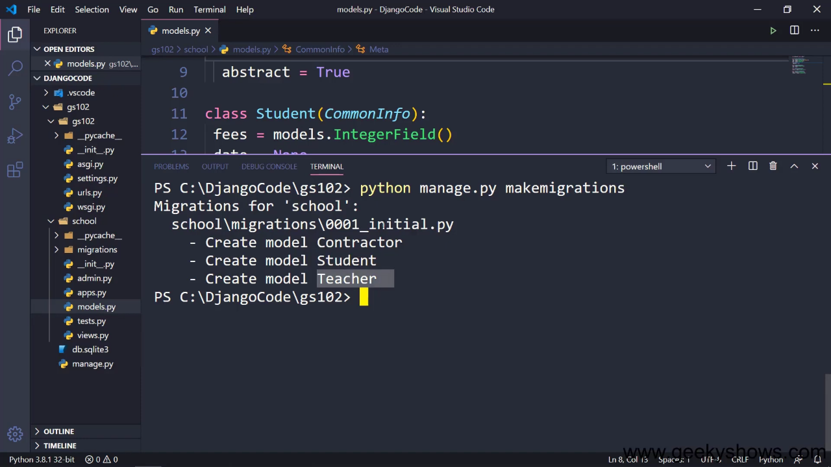

Slide 12
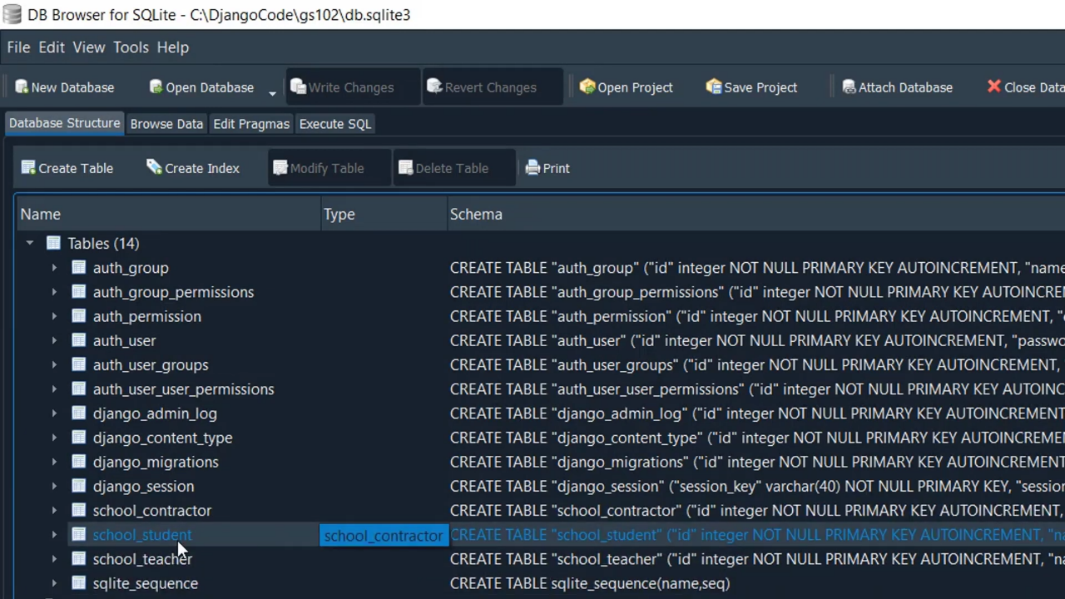

Slide 13
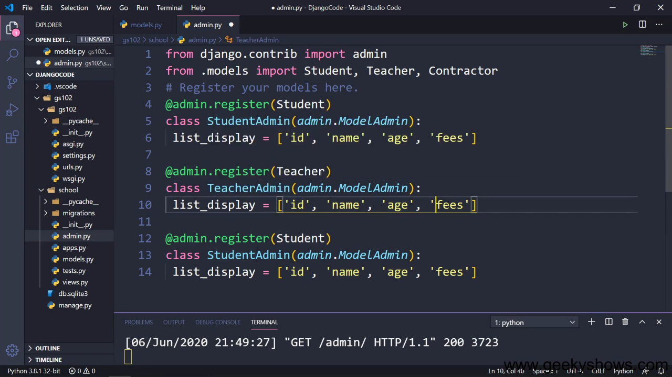

Slide 14
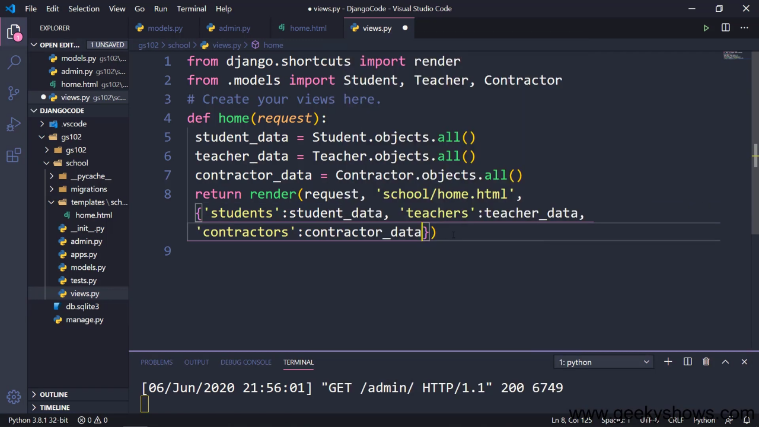

Slide 15
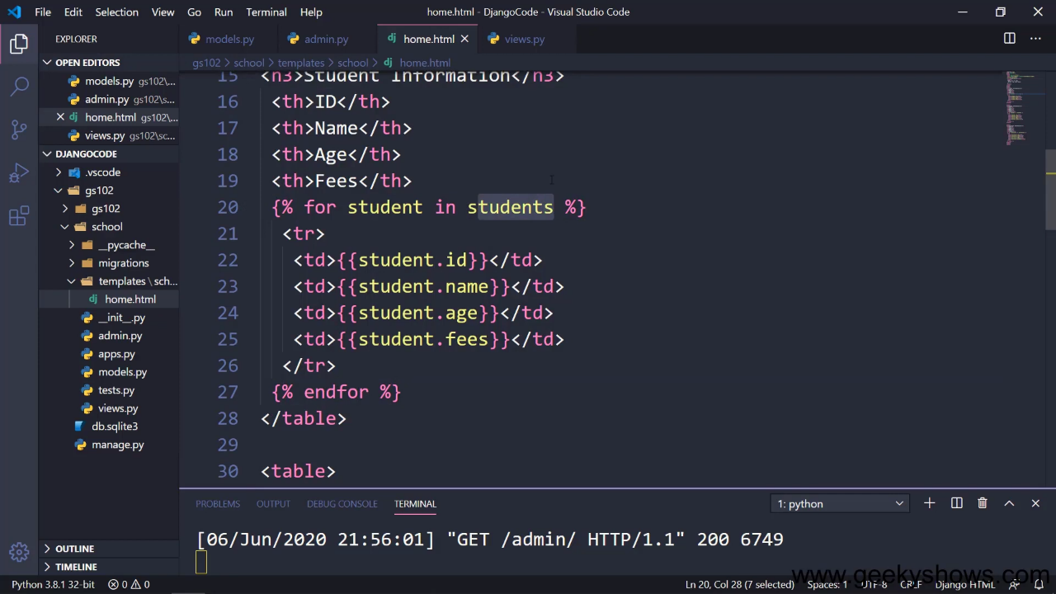

Slide 16
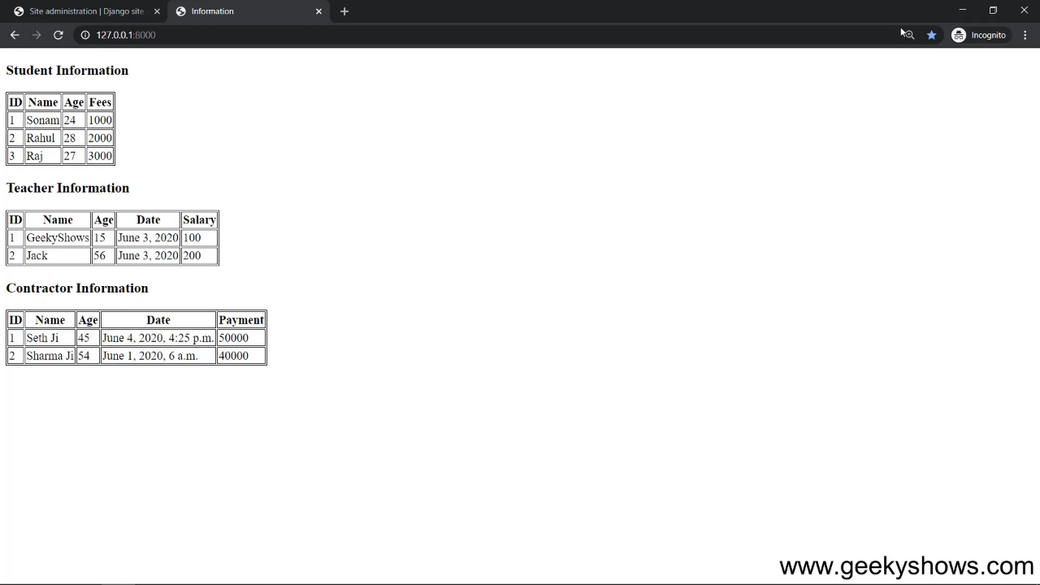

Slide 17
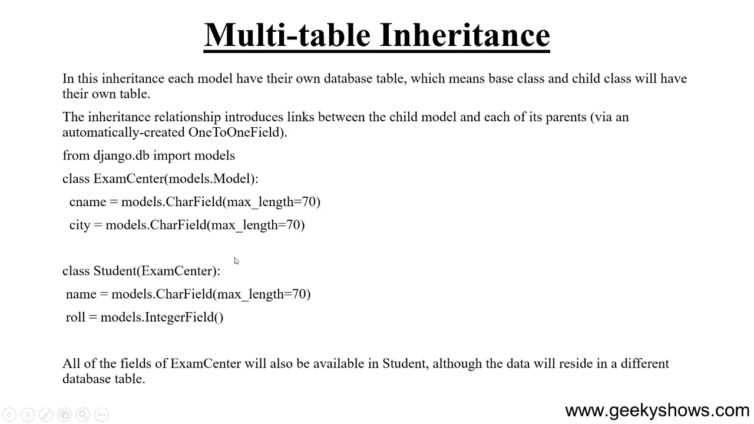

Slide 18
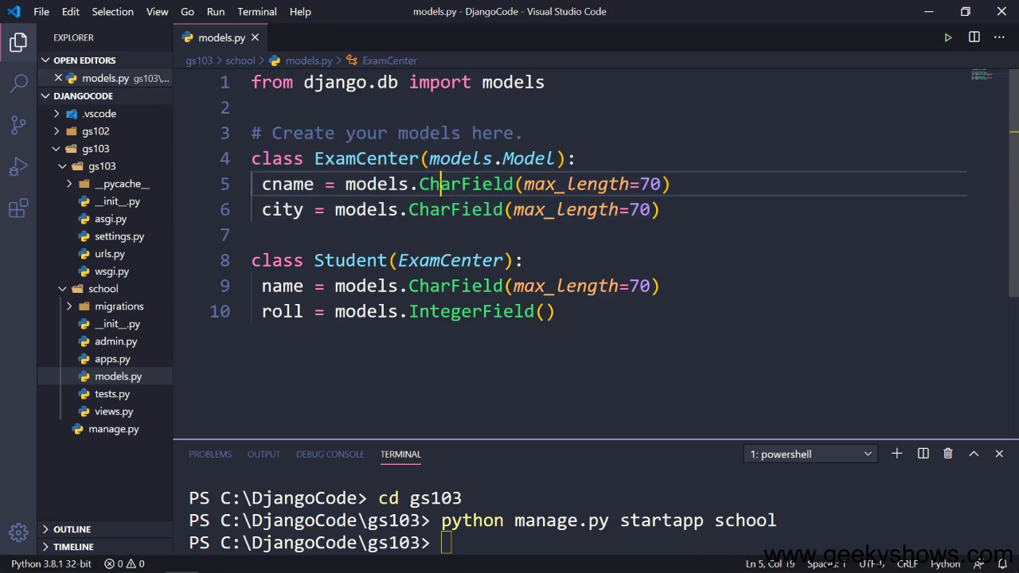

Slide 19
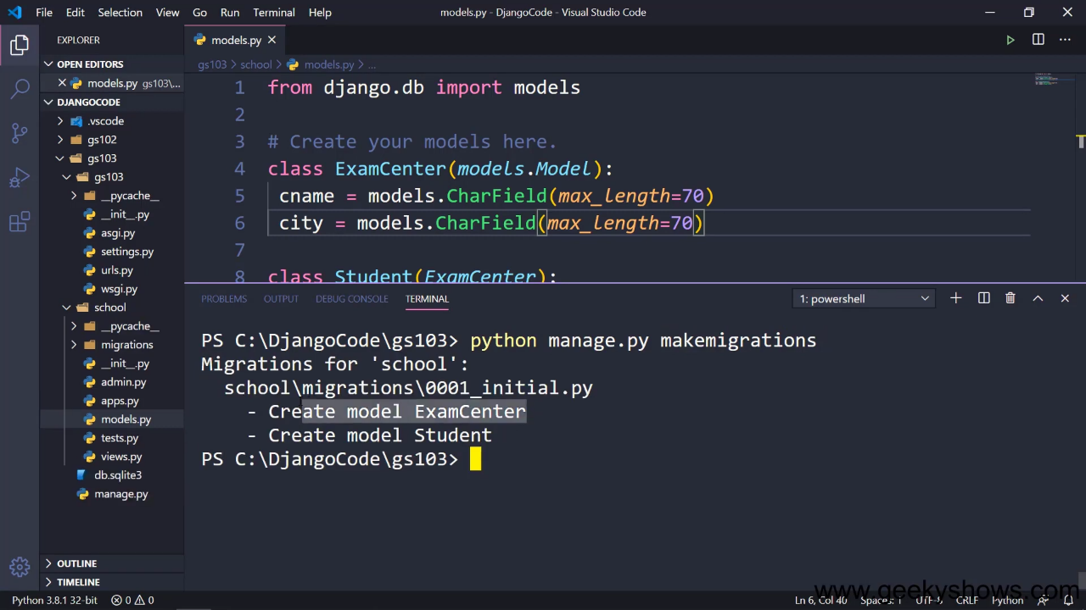

Slide 20
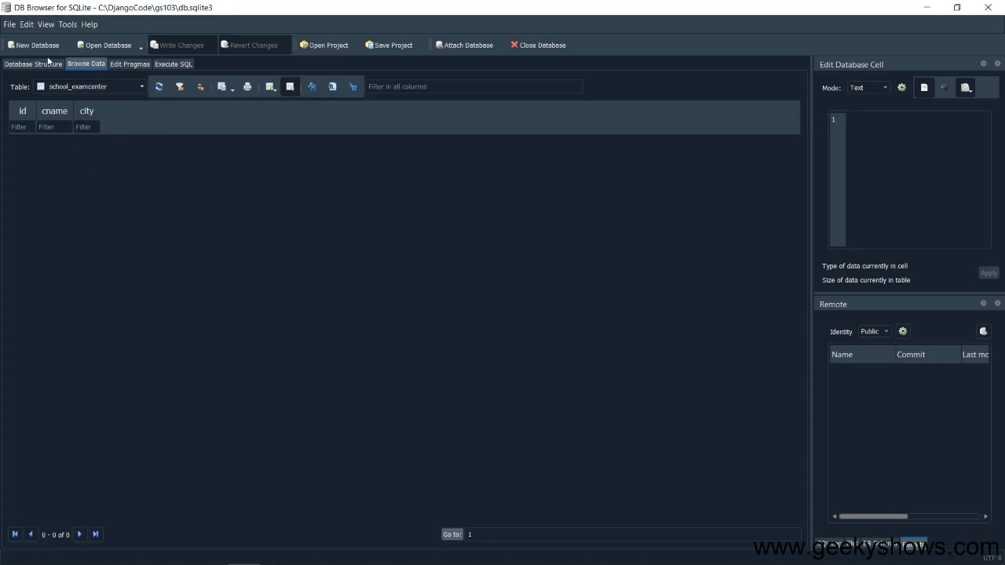

Slide 21
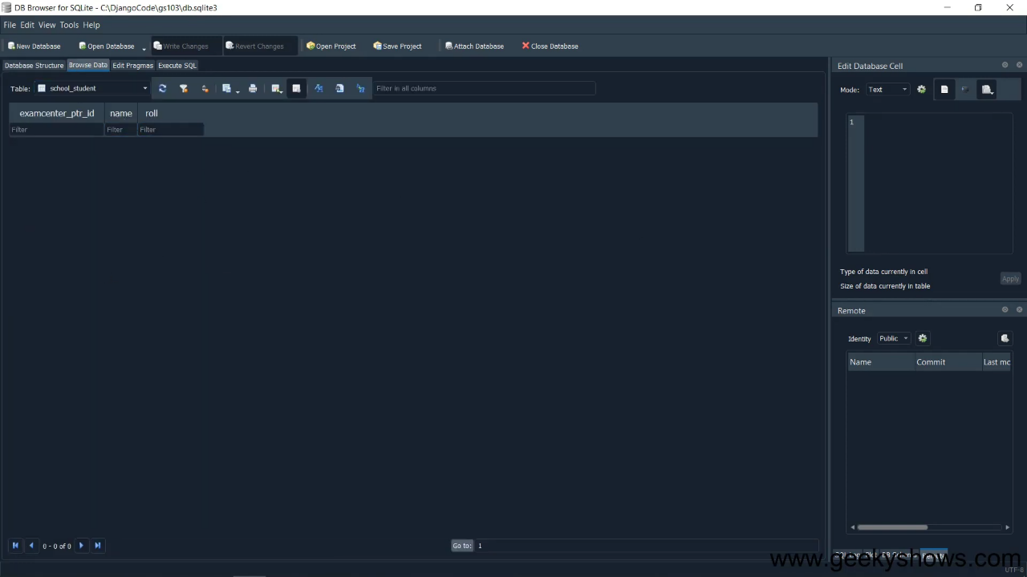

Slide 22
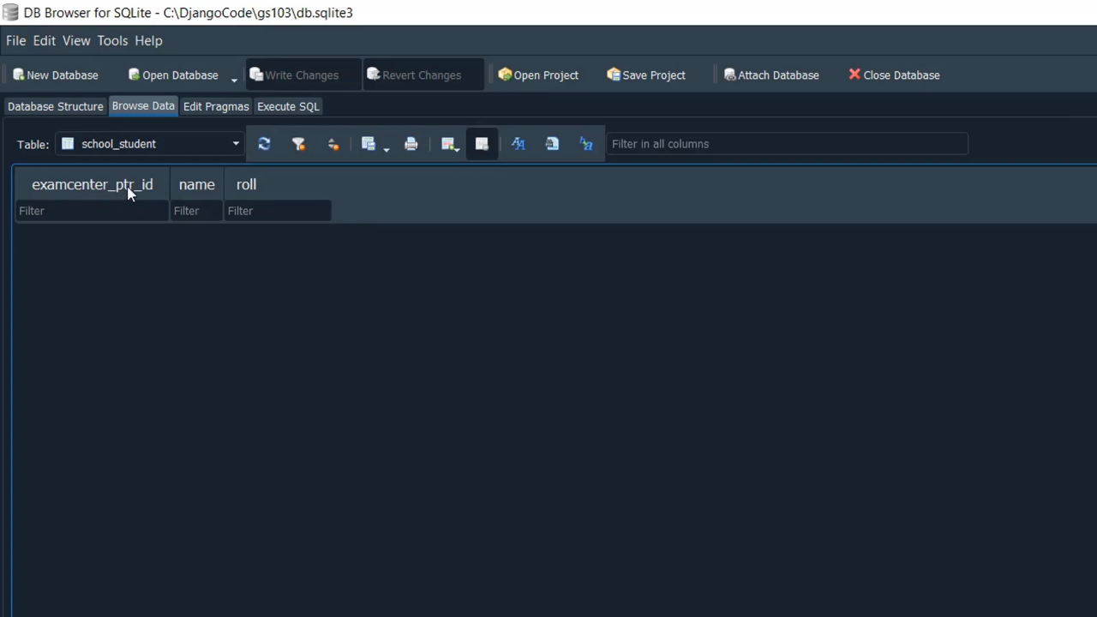

Slide 23
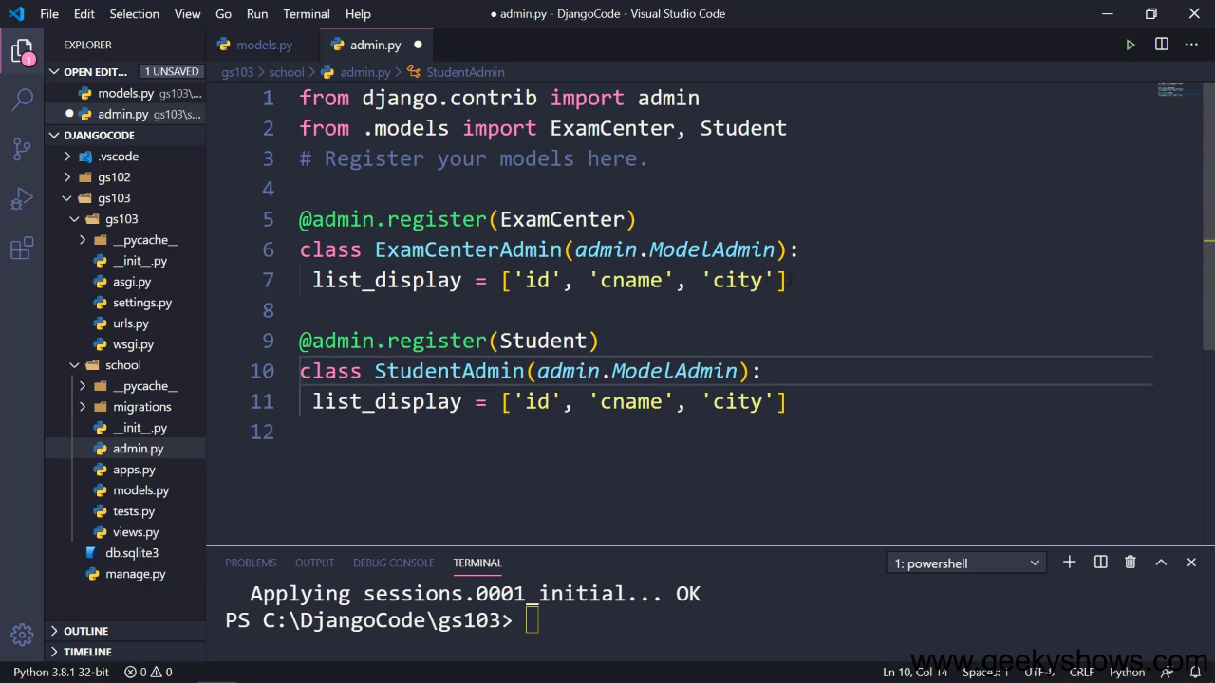

Slide 24
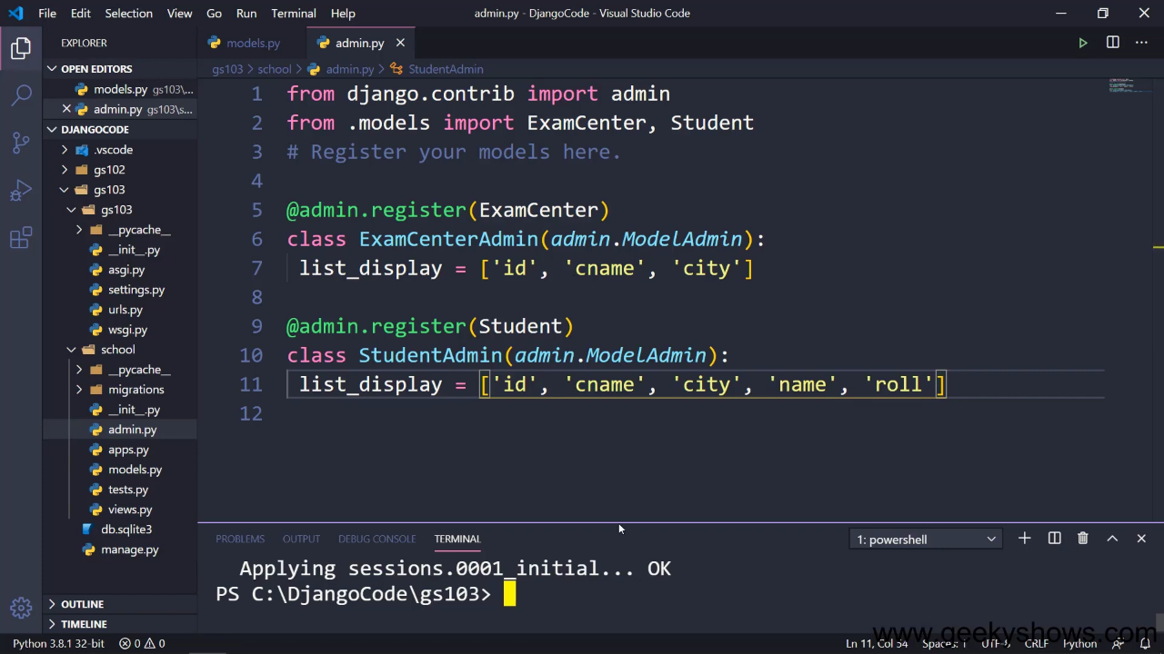

Slide 25
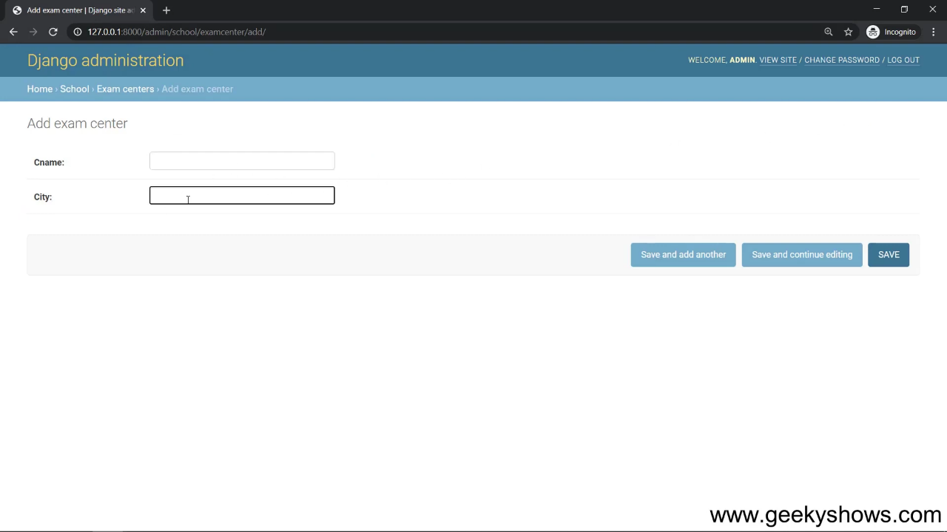

Slide 26
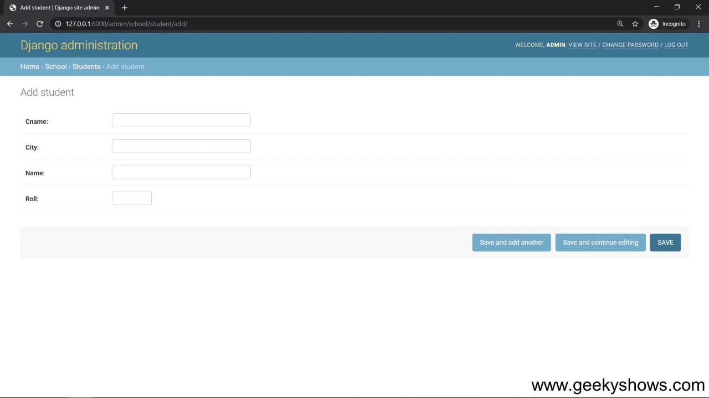

Slide 27
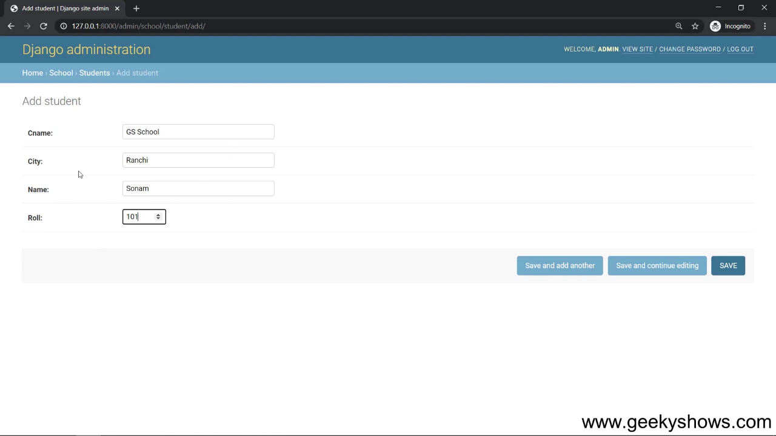

Slide 28
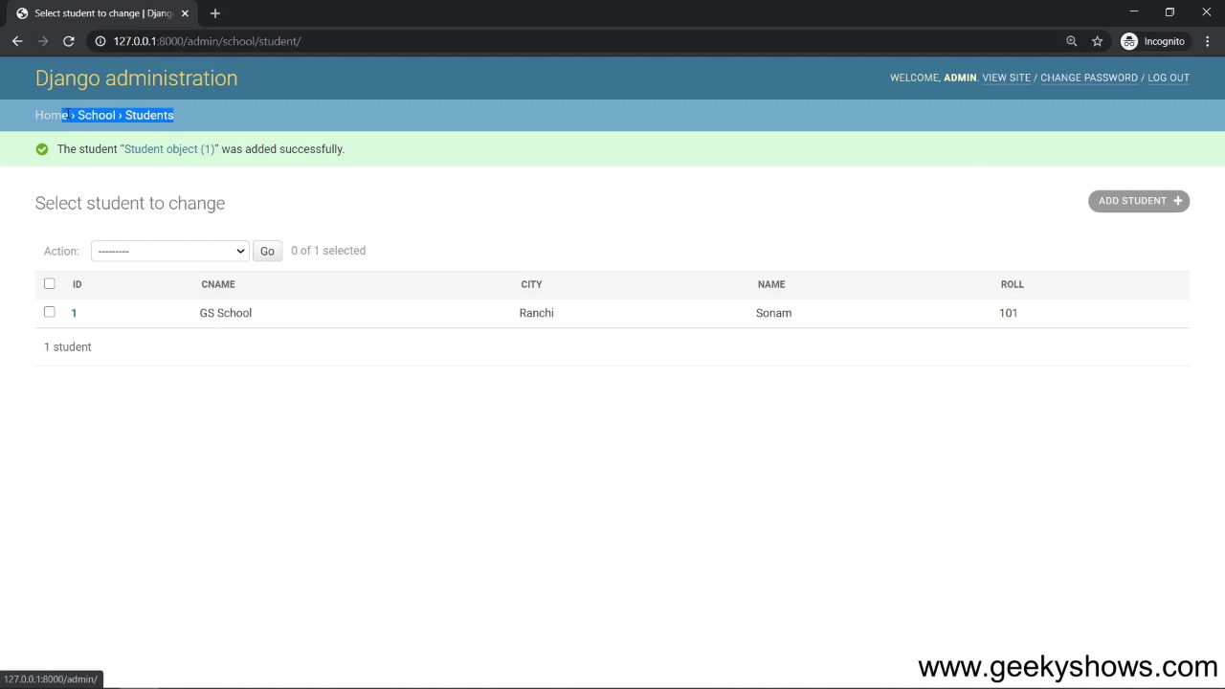

Slide 29
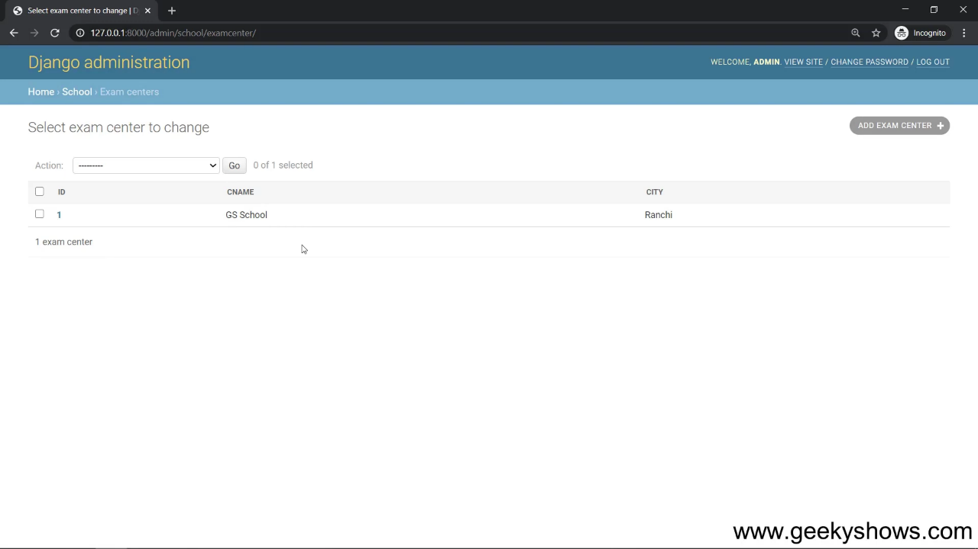

Slide 30
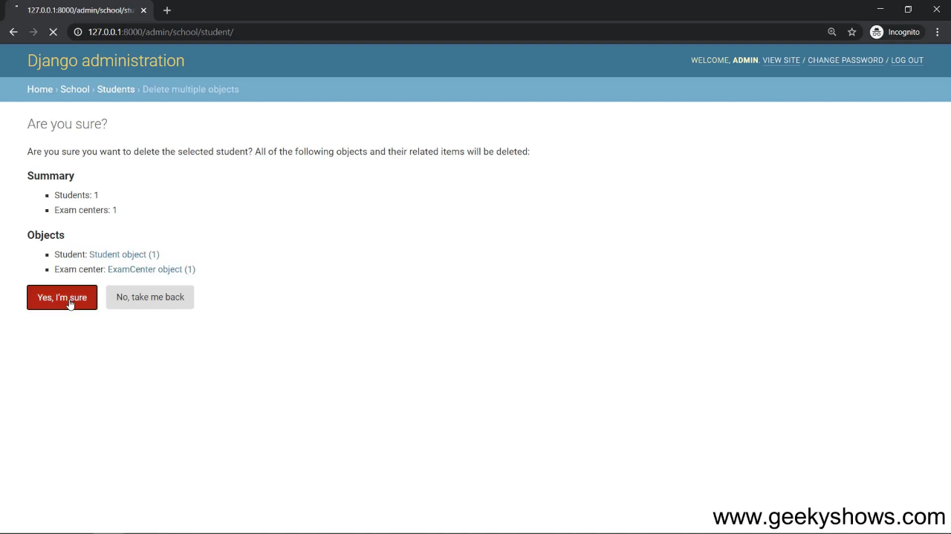

Slide 31
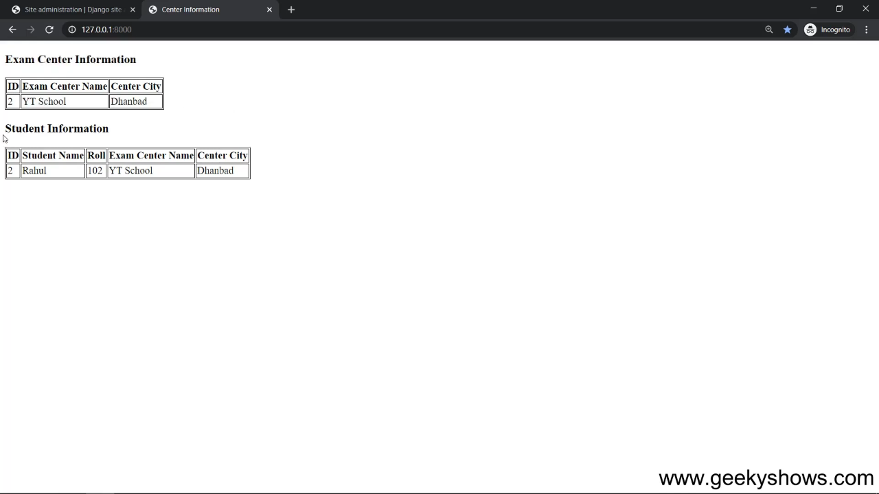

Slide 32
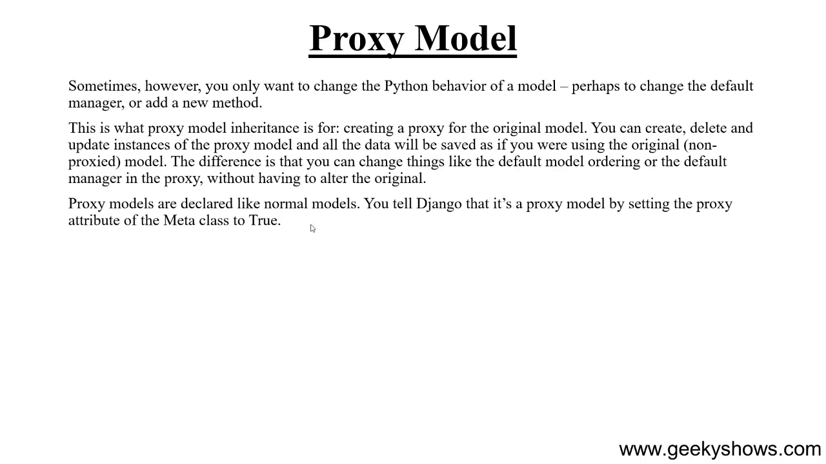

Slide 33
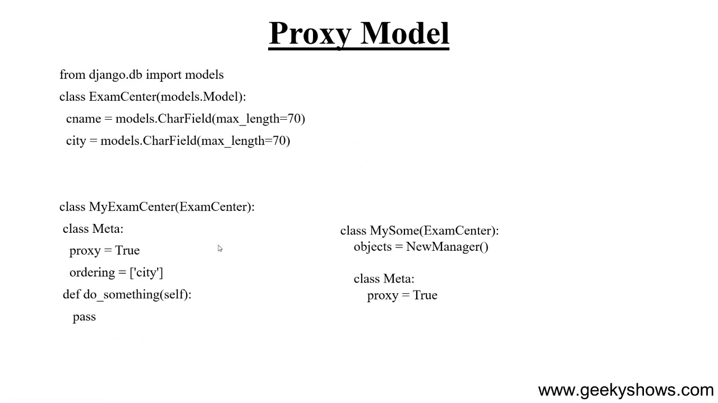

Slide 34
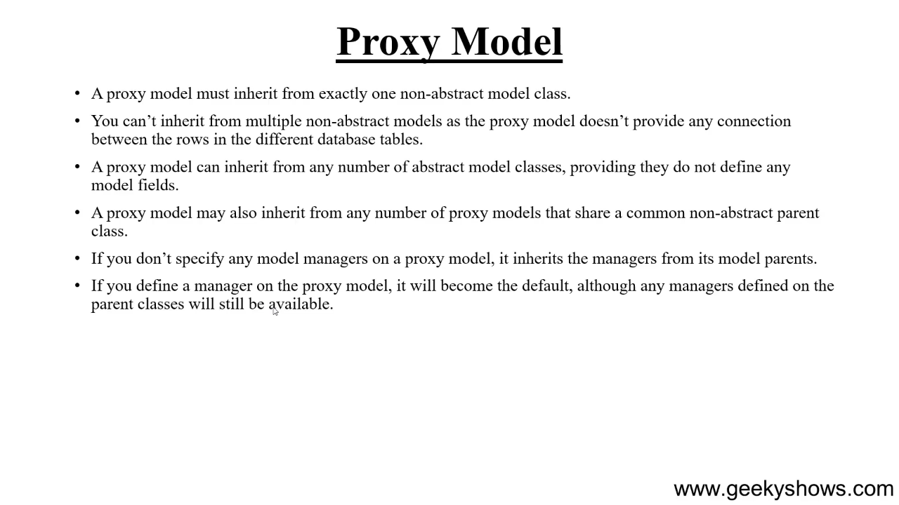

Slide 35
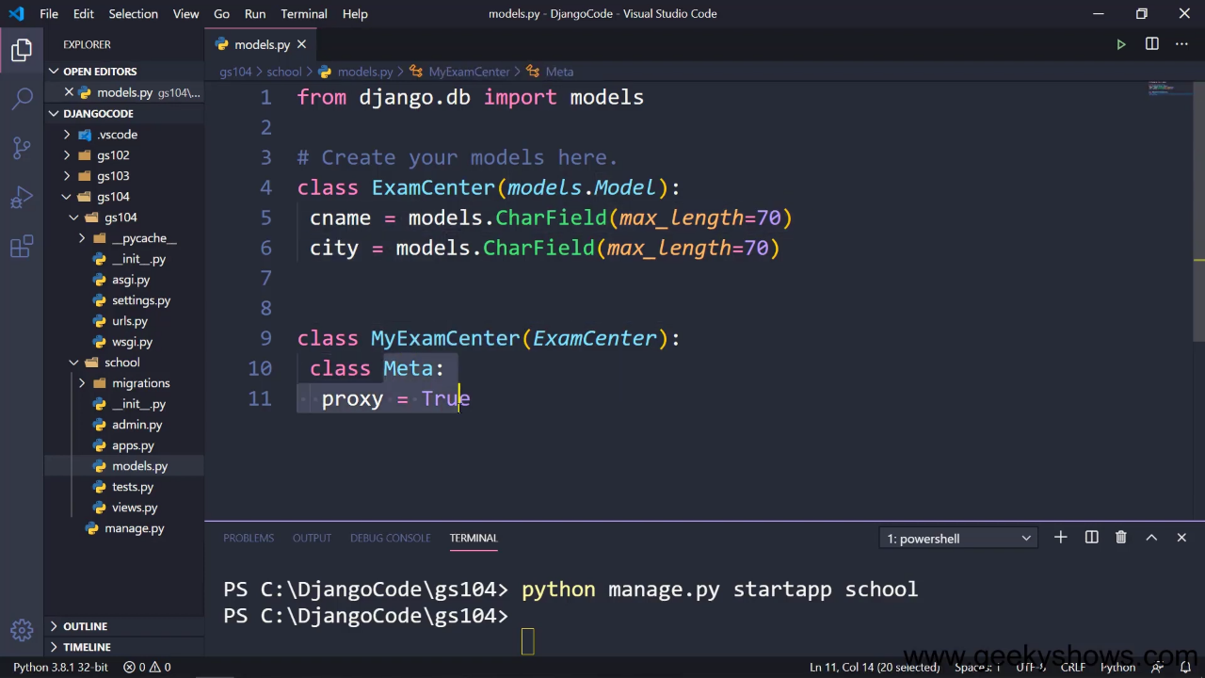

Slide 36
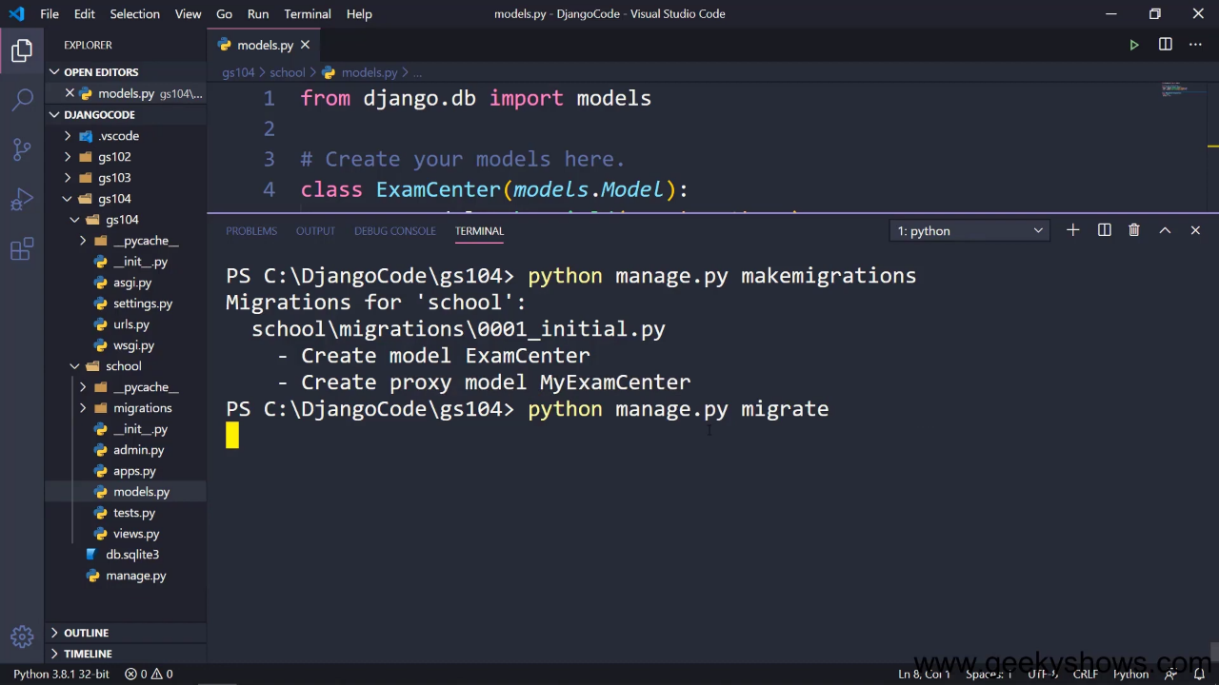

Slide 37
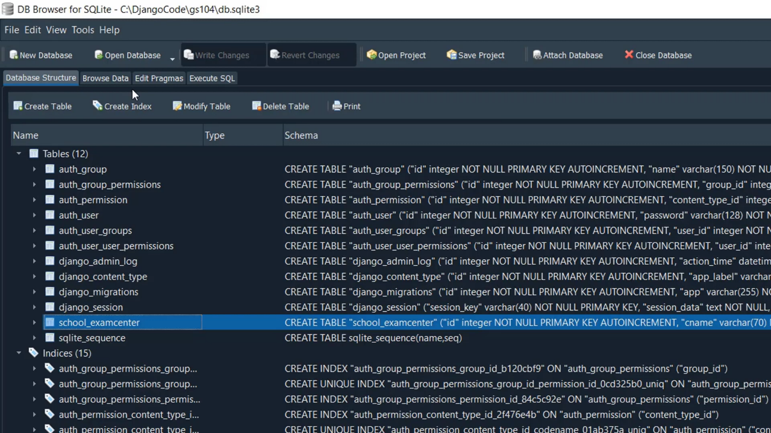

Slide 38
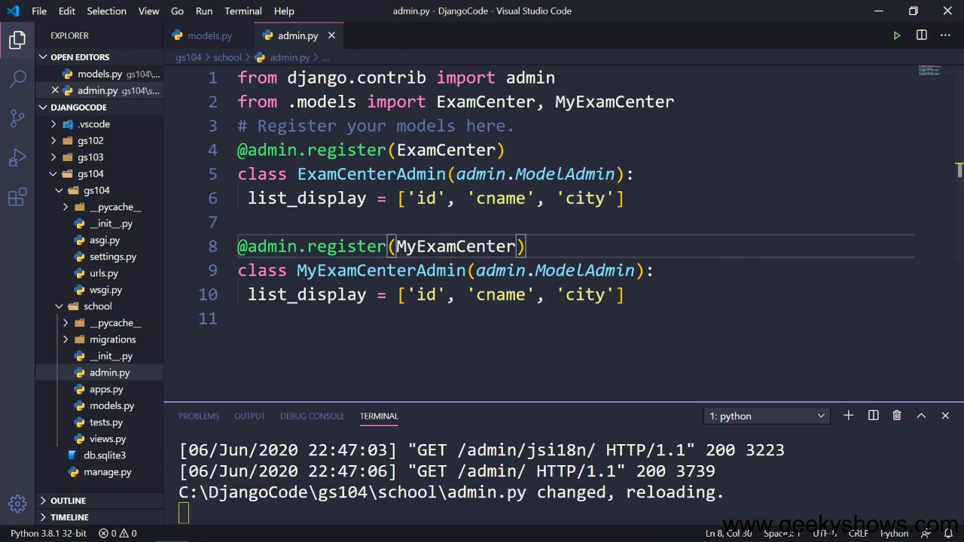

Slide 39
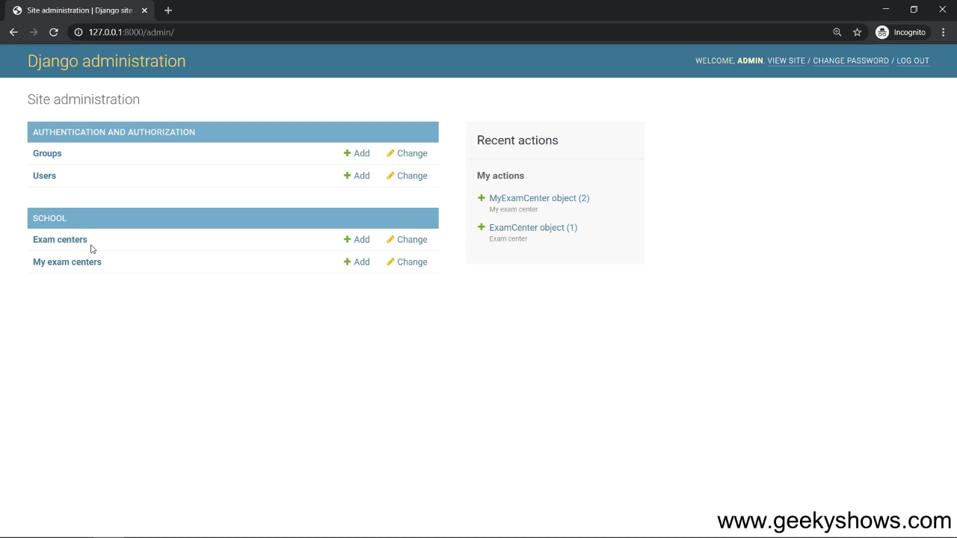

Slide 40
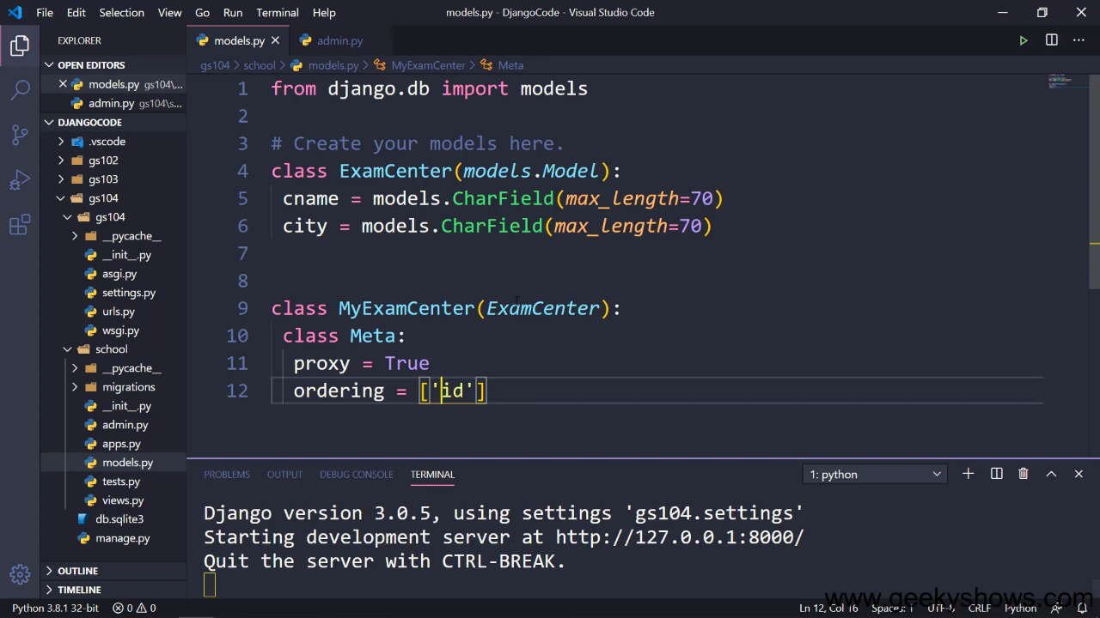

Slide 41
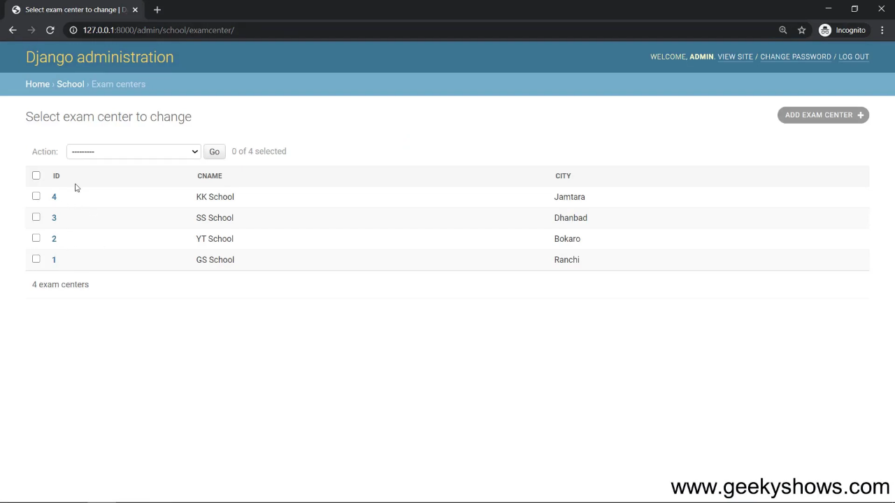

Slide 42
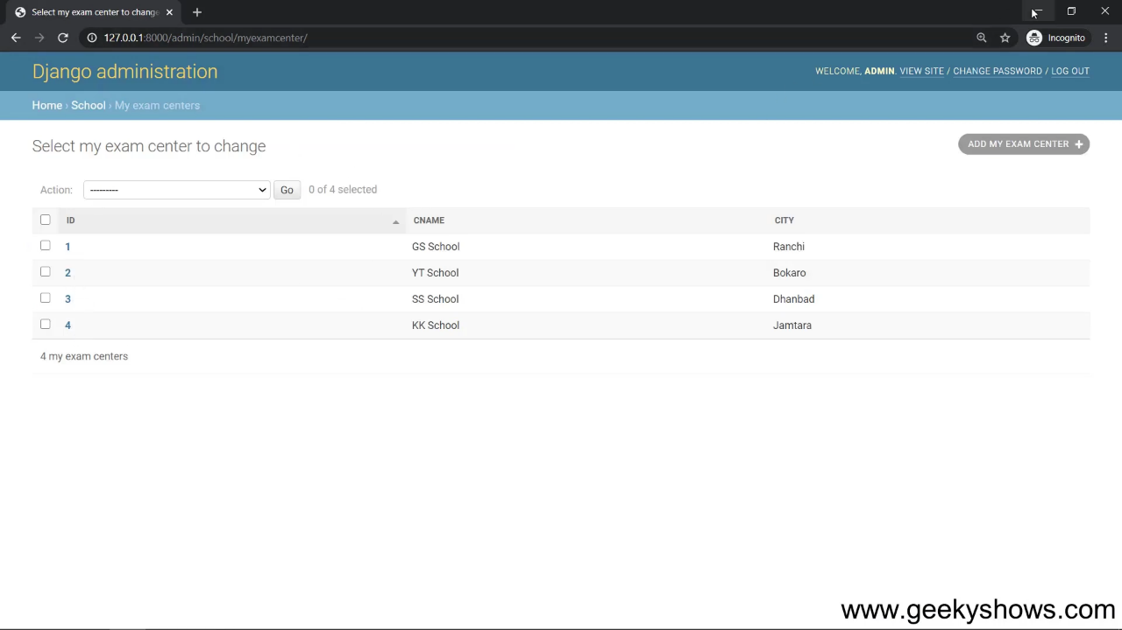

Slide 43
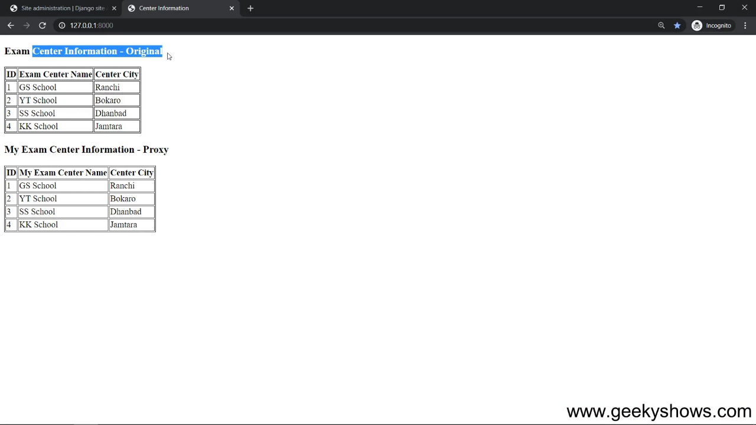

Slide 44
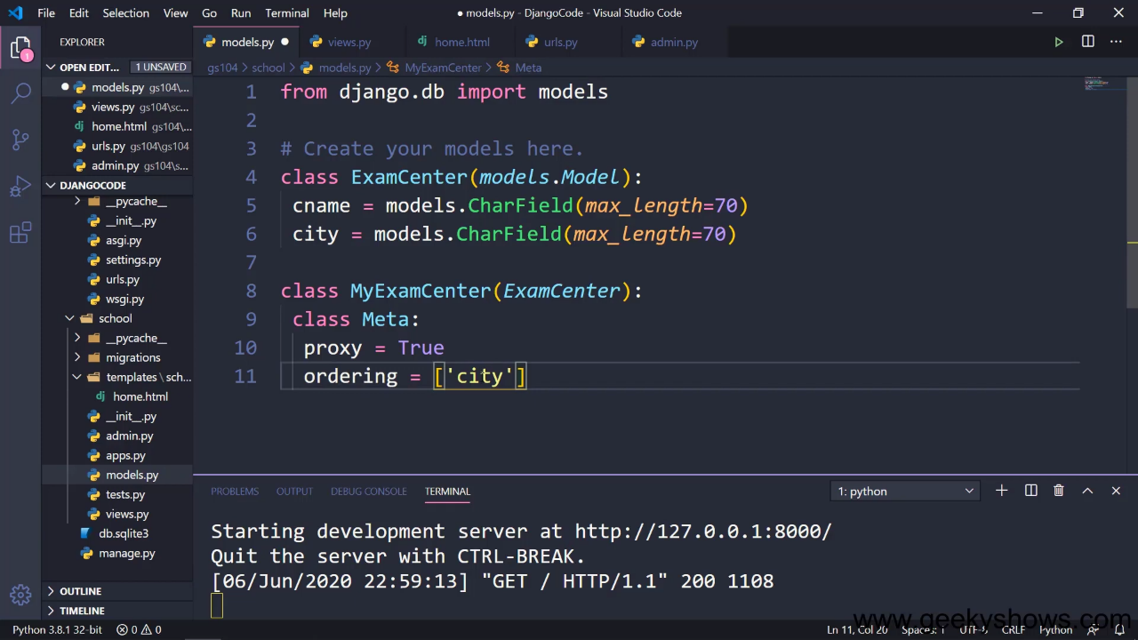

Slide 45
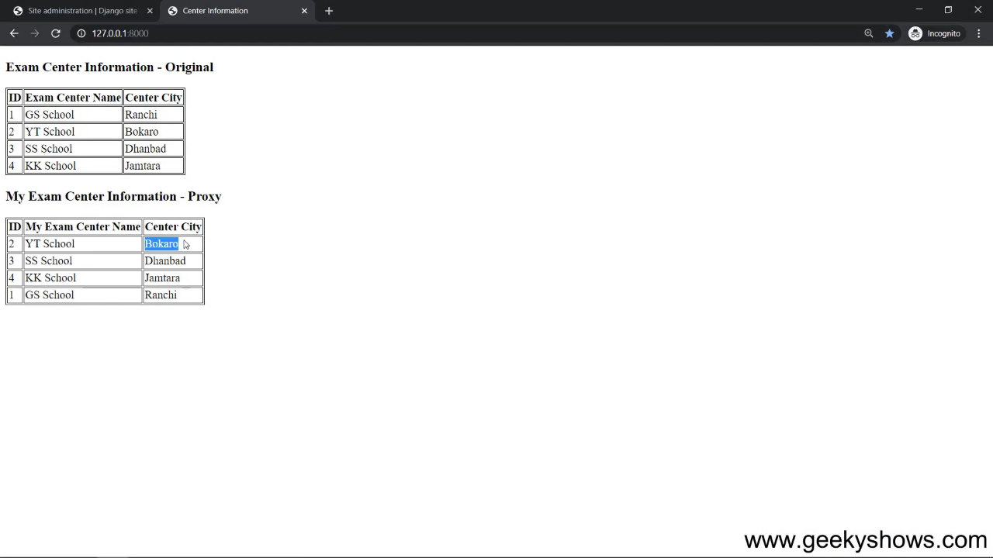

Slide 46
103. Model Manager in Django

Slide 47
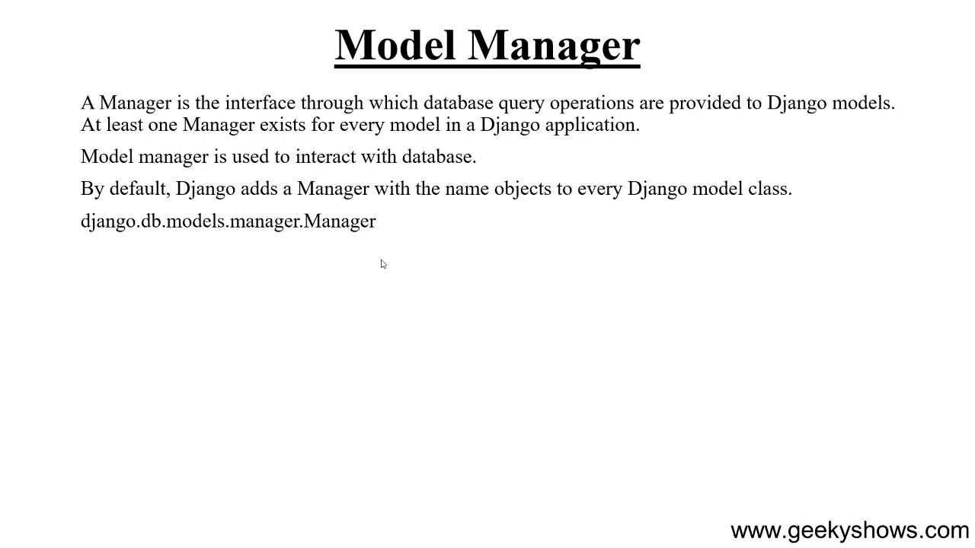

Slide 48
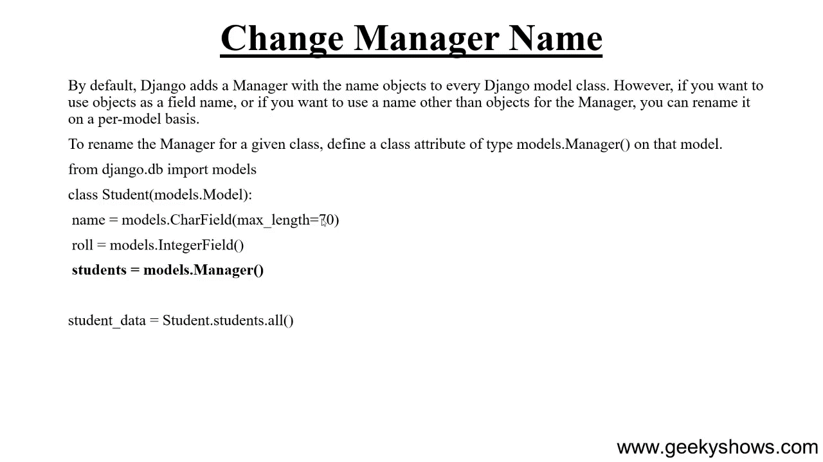

Slide 49
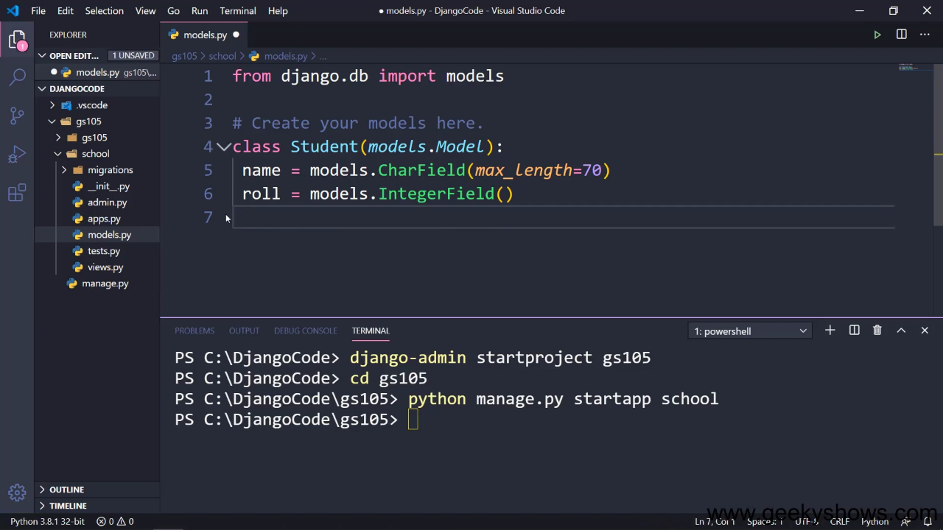

Slide 50
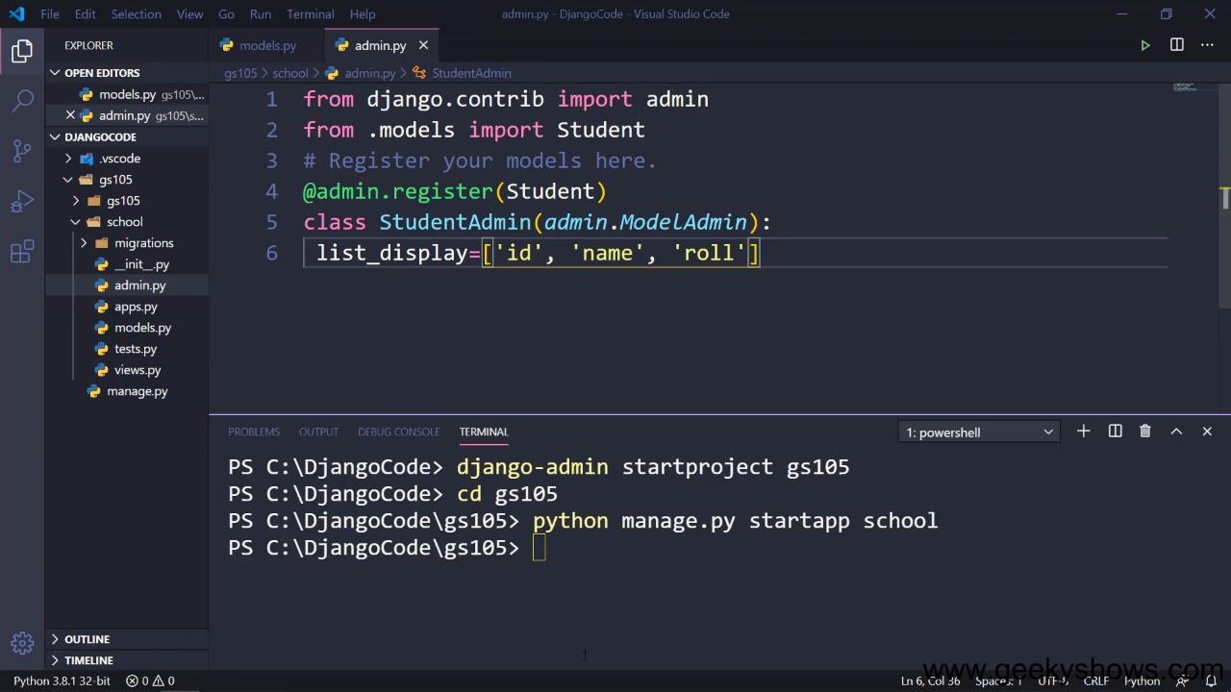

Slide 51
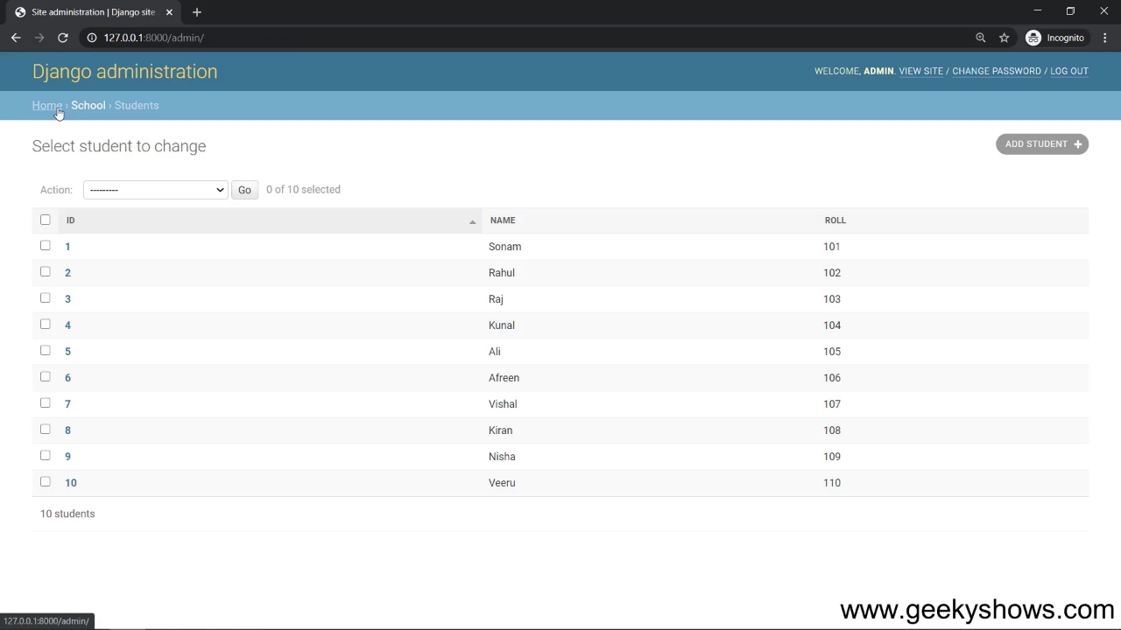

Slide 52
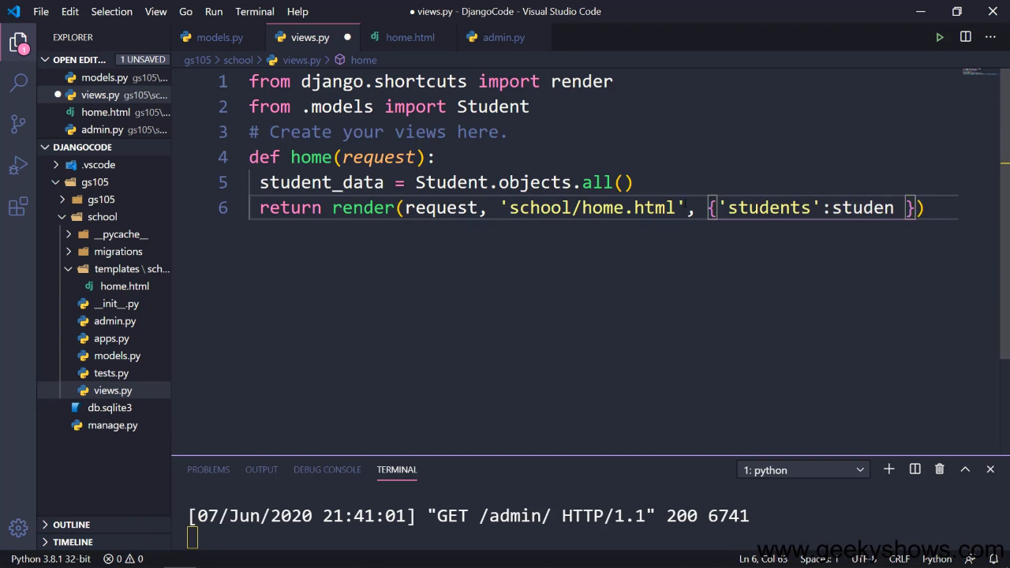

Slide 53
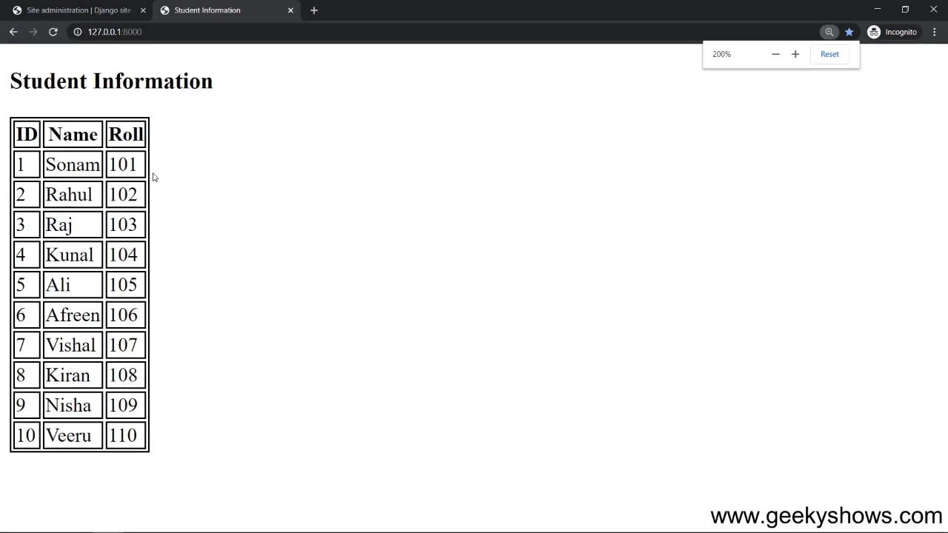

Slide 54


Slide 55


Slide 56


Slide 57


Slide 58


Slide 59


Slide 60


Slide 61


Slide 62


Slide 63


Slide 64


Slide 65


Slide 66


Slide 67


Slide 68


Slide 69


Slide 70


Slide 71


Slide 72


Slide 73


Slide 74


Slide 75


Slide 76


Slide 77


Slide 78


Slide 79


Slide 80
104. Model Relationship and One to One Relationship in Django

Slide 81


Slide 82


Slide 83


Slide 84


Slide 85

Model inheritance a auto onetoOne hoy user define one to one korte parent_link=True

Slide 86


Slide 87


Slide 88


Slide 89


Slide 90

User delete hoile page
O delete hobe auto

Slide 91


Slide 92


Slide 93


Slide 94

Because of onetoone

Slide 95


Slide 96


Slide 97


Slide 98

Page delete na hoile
User delete kora jabe na

Slide 99


Slide 100

Jara is_stuff
Tarai shudhu
Page create korte
parbe

Slide 101


Slide 102


Slide 103


Slide 104


Slide 105

Page delete hoile
Tar user delete korar
signal

Slide 106


Slide 107


Slide 108

BY DEFAULT
IN MODEL
INHERITENCE
onetoOne

Slide 109


Slide 110

“PANNA”
Parent_link = true na thakle
Auto default onetoOne
Relation hoy. User define korte
We used “panna”

Slide 111


Slide 112


Slide 113


Slide 114


Slide 115


Slide 116
105. Many to One Relationship in Django

Slide 117


Slide 118


Slide 119


Slide 120


Slide 121


Slide 122


Slide 123


Slide 124


Slide 125


Slide 126


Slide 127


Slide 128


Slide 129
106. Many to Many Relationship in Django

Slide 130


Slide 131


Slide 132


Slide 133


Slide 134


Slide 135


Slide 136

3 tables will be created

Slide 137

TABLE FOR SONG

Slide 138

TABLE FOR USER

Slide 139

TABLE FOR MANY TO MANY RELATIONSHIP
BETWEEN SONG AND USER

Slide 140


Slide 141


Slide 142
107. Model Relationship Example and related_name Parameter in Django

Slide 143


Slide 144


Slide 145


Slide 146

User er page er attribute page_cat
User er post er attribute post_publish_date
User er song er
attribute song_duration

Slide 147


Slide 148


Slide 149


Slide 150

Query korar shomoy model er
Class name “Page” use korte na
Chaile
related_name=“mypage”
Use kora jay

Slide 151


Slide 152


Slide 153


Slide 154


Slide 155


Slide 156


